Slide 1
Titleist Golf Project
Stat 795 Final Project
Aditya, Josh, Kelso

Slide 2
Outline
e Introduction/Methods
e Design of Experiment
e Model Selection/Diagnostics e Results
e Conclusion

Slide 3
Introduction
Problem
Titleist is suing a small business that is refurbishing used Titleist golf balls and selling them as new.
The company claims that since the balls are practically new that there is no difference in performance between new Titleist balls and the refurbished ones.

Slide 4
Introduction
Goal
We want to show that that there is a measurable difference in the performance of the different golf ball types
Showing a difference in a single metric constitutes a difference among ball types

Slide 5
Design of Experiment
Randomization is key to any Experimental Design
Power of .95 used to determine optimal sample size
Primary golf ball characteristics of note:
Distance
Accuracy
Control

Slide 6
Design of Experiment
We will first check distance, and then go from there if there is no measurable difference among ball types.

Slide 7
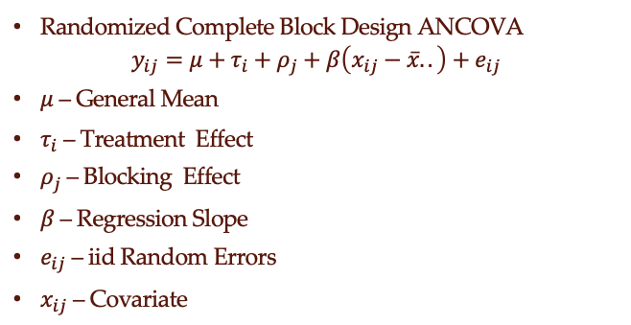
Design of Experiment
Randomized Complete Block Design ANCOVA
$$y_{ij}=μ+τ_{i}+ρ_{j}+β\left(x_{ij}−\overline{x}..\right)+e_{ij}$$
$μ$ – General Mean
$τ_{i}$ – Treatment Effect
$ρ_{j}$ – Blocking Effect
$β$ – Regression Slope
$e_{ij}$ – iid Random Errors
$x_{ij}$ – Covariate

Slide 8
Design of Experiment
N
W
N
R
R
W
Block 1
W
N
W
R
N
R
Block 2
N
R
N
W
R
W
Block 42

Slide 9
Data Set
Multiple measurements taken for each shot
Total Distance
Total Dispersion
Carry Dispersion
Carry Distance

Slide 10
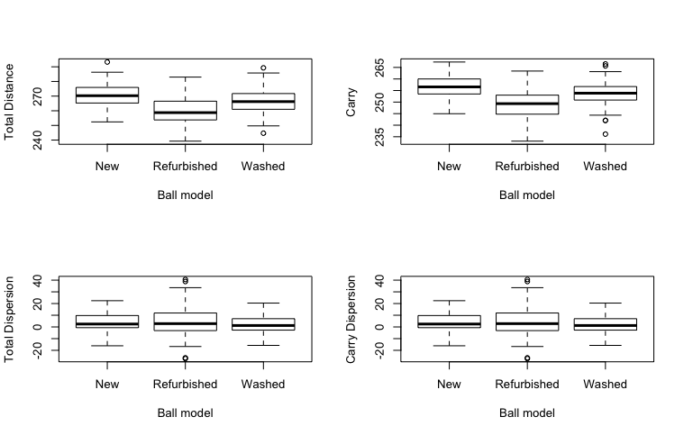
EDA

Slide 11
EDA

Slide 12
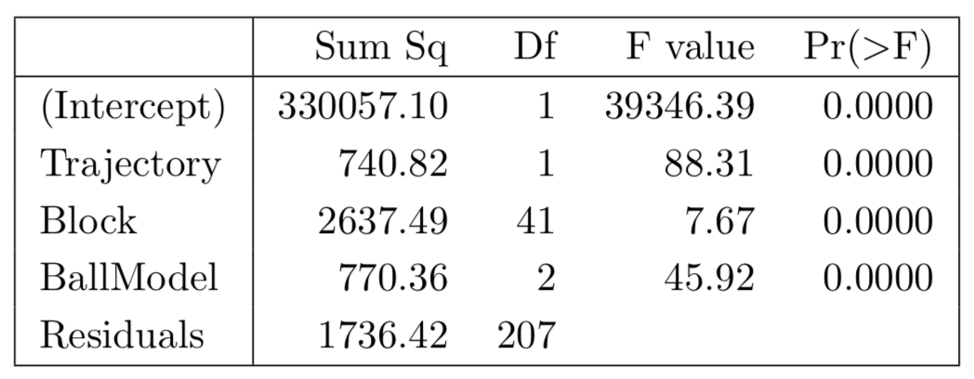
ANCOVA Model
Type III SS for Carry Distance

Slide 13
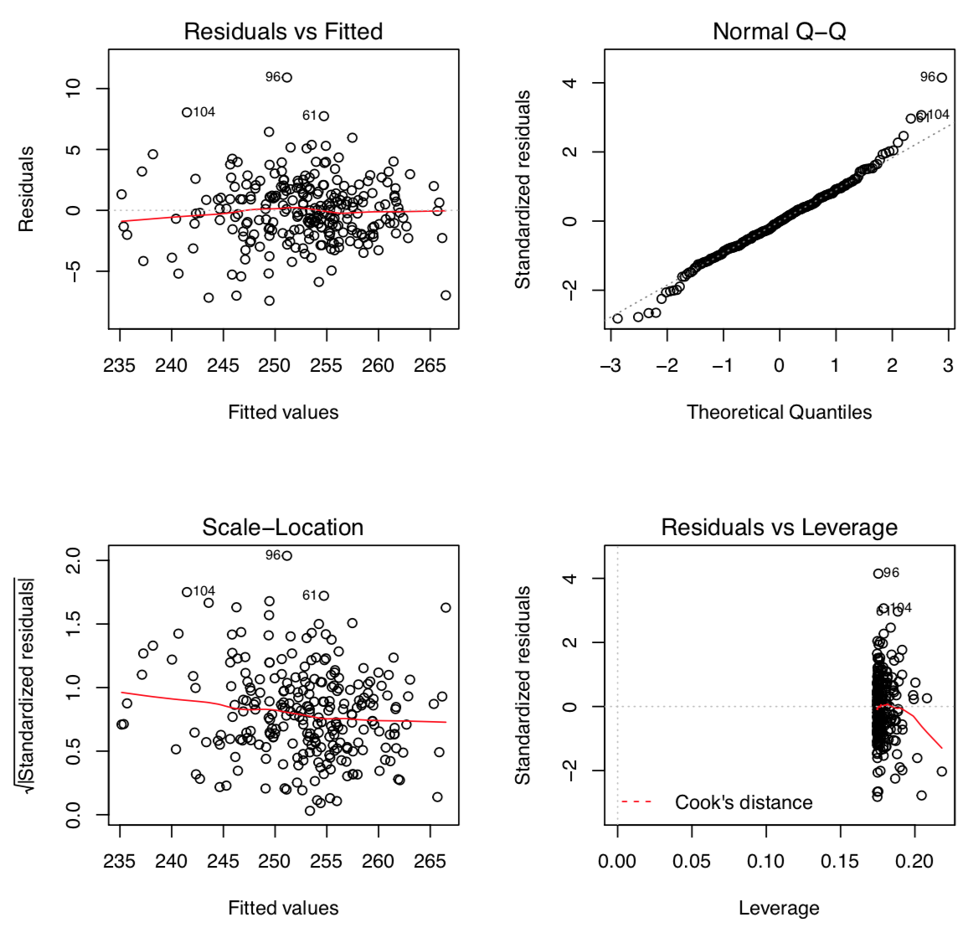
ANCOVA Diagnostics

Slide 14
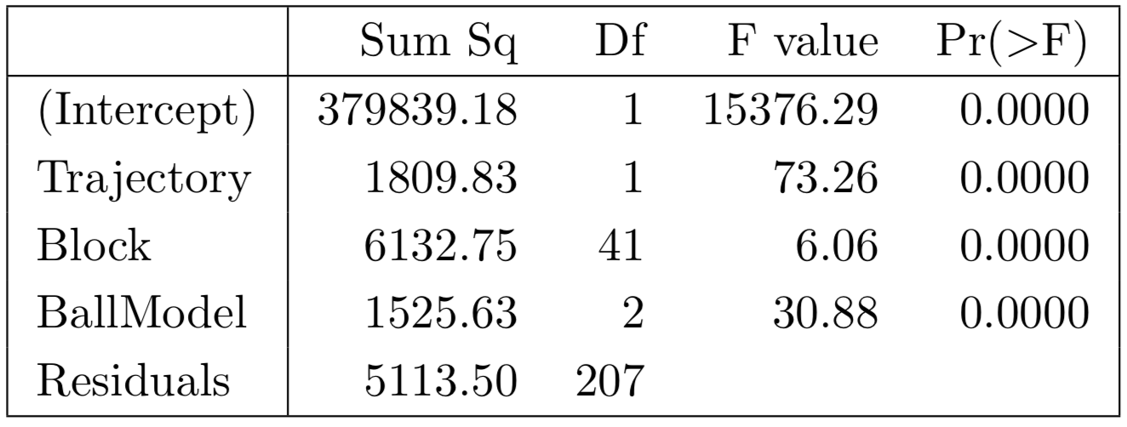
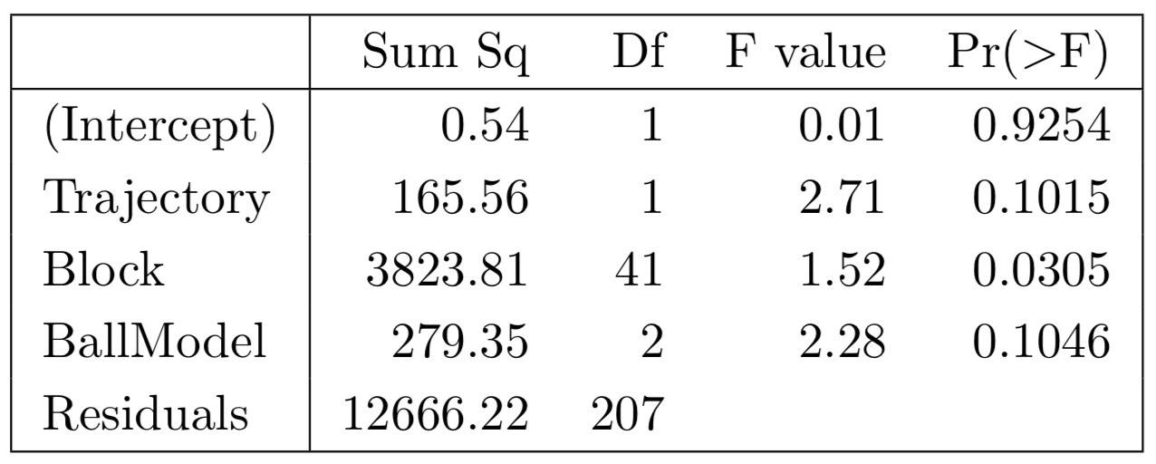
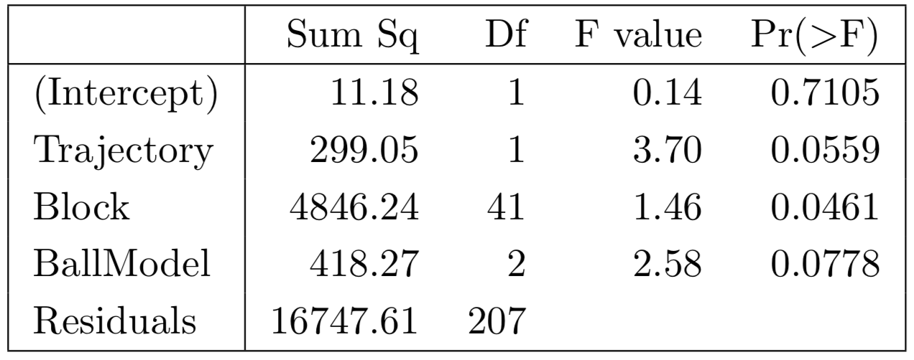
Results
Carry Distance
Total Distance
Carry Dispersion
Total Dispersion

Slide 15
Conclusion
Both measures of distance (carry and total) had treatment effects that were highly significant.
Measures of dispersion depended on the blocks they were placed in. This indicates wind had a significant impact on dispersion more so than the ball type used.

